Slide 1
CySyphus
Kinetic Art Table
Project Plan
Sean Gordon, Morgan Funk, Aaron Lawrence, Daniel Laracuenta, William Maston, and Samuel Christianson

Slide 2

Key Technical Goals
Create web hosted web applications for ease of access.
Implement system to more easily create table tracks.
Create algorithms for converting photographs to table tracks.
Link table wirelessly to our web interfaces.
Notes:
Hello, my name is Sean Gordon, and I will be speaking about our project’s key technical goals.
Our project focus is around augmenting the Sisyphus table for freedom of expression and ease of use, and will be implemented largely using software. We will be hosting our user interfaces on the internet, allowing secure connections between a user and their table.
As part of the planned applications, we will be implementing several systems to more easily create tracks for the table to use. One of these systems will be converting photographs into tracks, requiring minimum effort for maximum results.
Once these applications are hosted on the internet, we will also need a way for them to communicate with any given table. This is planned through wireless communication using an arduino or other wirelessly capable device. The device is planned to be relatively inexpensive and easy to install, allowing for repeated production and distribution.

Slide 3
Other Technical Goals
Twitch Plays CySyphus.
Through the use of the famous streaming platform Twitch.tv, we will have a direct user interaction where the community will decide what will be drawn based on images.
Create algorithms to convert tracks between polar and cartesian coordinate types.
Live marble mapping.
Since we will have a device (Ex. IPad) that will be used for direct live user interaction, we will want to be able to be able to draw live as the user draws.
Notes:
Hi, my name is Daniel Laracuenta and I will be talking about our project’s Other Technical Goals.

Slide 4
User Introduction to System
Users need a mode of introduction to our system to allow them to properly know how to use and effectively work with the many intricacies our system has. ( These are just ideas. )
Projector
This idea could effectively communicate things like apps, url’s, QR codes straight directions to allow for a user to be properly introduced to our system and how it works.
iPad
One idea for users to get introduced to our table and possibly interact with our system is to have an iPad system set aside that will aid in user introduction and also possibly table interaction.
App
Livestream
Notes:
Hi this is Aaron Lawrence and I will be talking about how we will be introducing ways in which users can interact with our table.
One of the ideas that we’ve come up with is a projector, this would display things like apps to download, QR codes and or directions on the rim of the table and act as a perfect way of project advertisement.
The next idea we had was to have an iPad stationed next to the table. This could also be used in the exact same way as the projector but in addition have things like active drawing and active table interaction.
Lastly we have thought about developing an app system that users can download and or streaming the table’s drawing process online on sights like twitch.

Slide 5
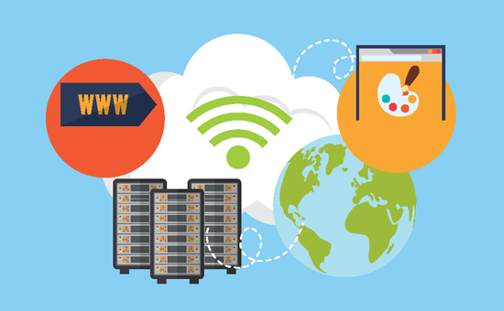
Mechanisms for User Interaction
The Main CySyphus Website
A digital canvas for user to create custom tracks.
Draw function
Give the user basic mouse and keyboard draw tools
Would be great if it also worked on phone
Scan photo
Requests a file from the user
Photo is displayed to the user for confirmation
File is sent to server for translation
A stream for users to watch the table drawing online
Twitch Stream
Youtube Stream
Notes:
My name is William Maston and this is a review of how users will interact with our project.
There will be two main vectors of interaction in our project. The first being the creation of a website that allows users to input drawings for the table to draw. The website will support an online html based draw function, accepting the users mouse and keyboard as inputs. The website will feature draw tools like free form drawing, straight line, basic shapes, and other common drawing functions. The other way the website will accept information is by taking picture uploads from the user. The website will convert the picture into a file that the table will read and then send it to the table for display.
The second way Users will interact with the project is from a viewing experience. A video camera will record the table and send the video to streams like Twitch and Youtube, where the user can view the table online.

Slide 6
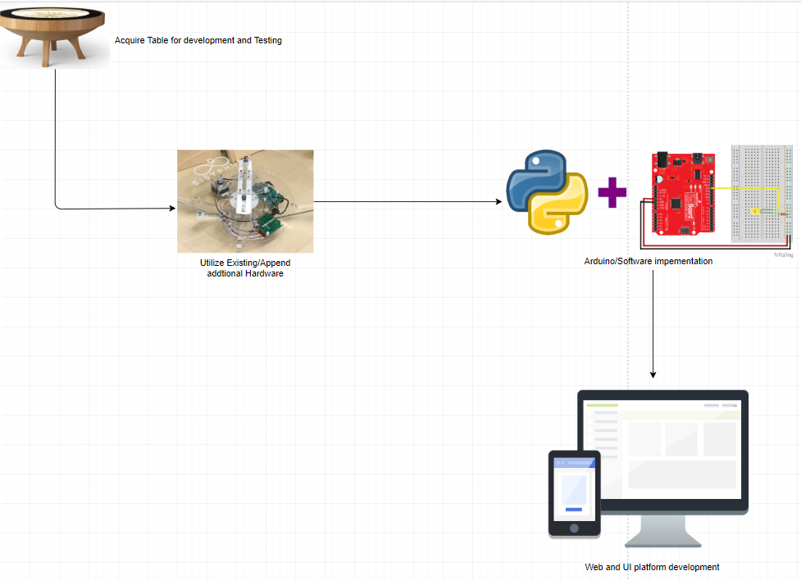
System Diagram
Our current proposal for implementation of the “Cy”Syphus table has 3 main elements: Table Hardware implementation, Software development, UI and platforms.
Notes:
The system diagram for our current proposal has 3 main elements that will be the main focus of our development. Prior to any development however we must remain in contact with our client in order to get an accurate timeline of when development can begin as acquiring a table for a testbed is high priority to understanding and implementing our systems. Once we are able to get our testbed familiarize ourselves with the hardware/software elements of our current system, we will be able to see how we can add additional hardware or even utilize the existing hardware to interact with custom software elements we develop. Next, the bridge between software and hardware can be created and testing from a software standpoint can begin. There are community elements for customized table pathing we can implement or at the very least use as a basis for our software development. Finally, once the prior elements have been completed we start development on the UI and Web platforms that the user would utilize in order to interact with the table itself.

Slide 7
Project Timeline
Planning and research
First phase: Understanding the table
Understand the limitations
Develop a solid understanding of how images display
Second phase: Software prototyping
Creating a software layer between user interaction and the table that includes
Web interface system that connects to a table
Process for converting cartesian coordinates to polar coordinates
Third phase: Develop interaction hardware and software
This includes all the software and hardware that are used to interact with the table such as:
Application to upload pictures or drawings
“Twitch plays” interaction
Interaction with a camera such as a caricature or portrait
Notes:
My name is Samuel Christianson and i will be talking about our project timeline

